Slide 1
Python environments demystified
BJSS Academy

Slide 2
What does This all mean?
There is often a lot of confusion around dealing with Python environments
Many words have similar names but mean quite different things
By the end of this talk you will hopefully understand the following:
How does Python work on my machine?
Python versioning and pyenv
What is a virtual environment?
How can we create virtual environments?
What is dependency management and how can we do it?

Slide 3
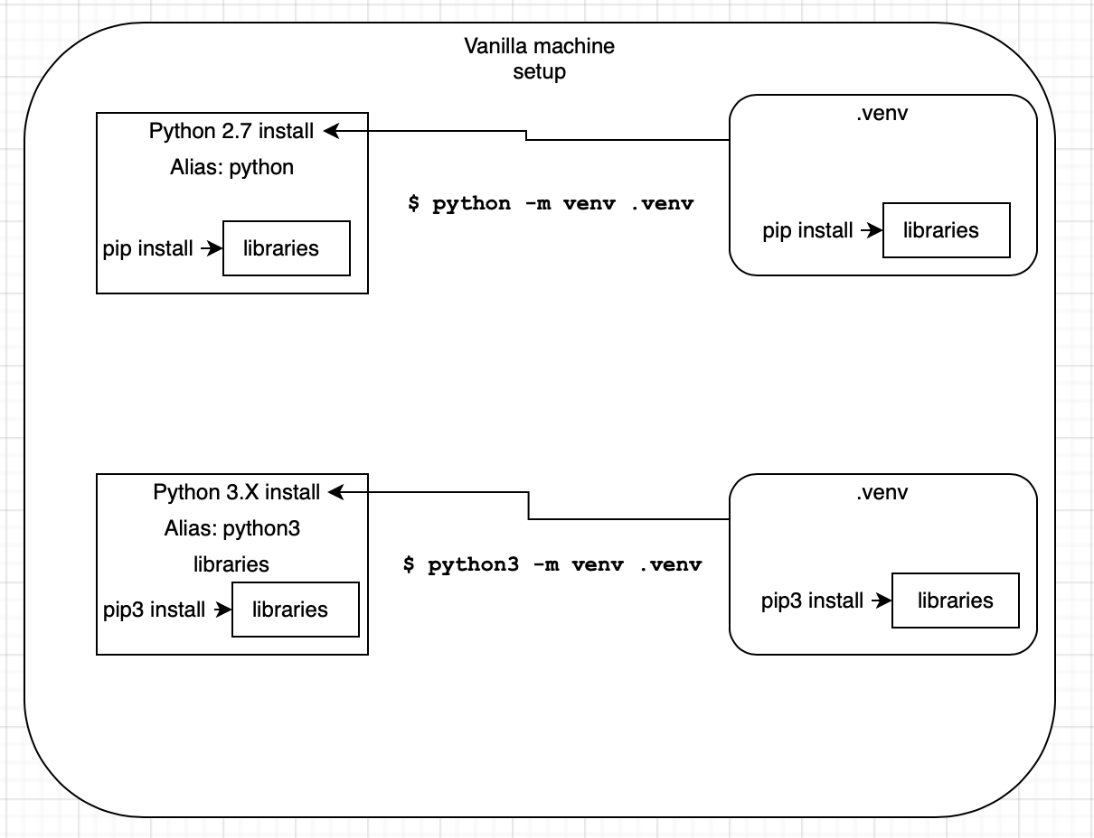
Vanilla python install
Generally, a machine will have an install of Python 2.7 and some Python 3 version
To access Python 2.7, the alias python is used and for Python 3, python3 is used
Each install of Python will have a set of libraries associated with it
These can be installed and managed using pip
When either of the Python aliases are used, the associated libraries are accessible
By having only one set of versions of libraries, issues can arise with different project requirements

Slide 4
Virtual environments
To alleviate this issue, virtual environments are used
There are several tools that can be used to create them such as, venv, pipenv, poetry etc. We will use venv for this example
The virtual environment will point to the Python version it was created with and create an environment without the global libraries
This allows the user to install the exact versions of given libraries without fear of dependency clashes
The virtual environment is completely separate of all other Python environments

Slide 5
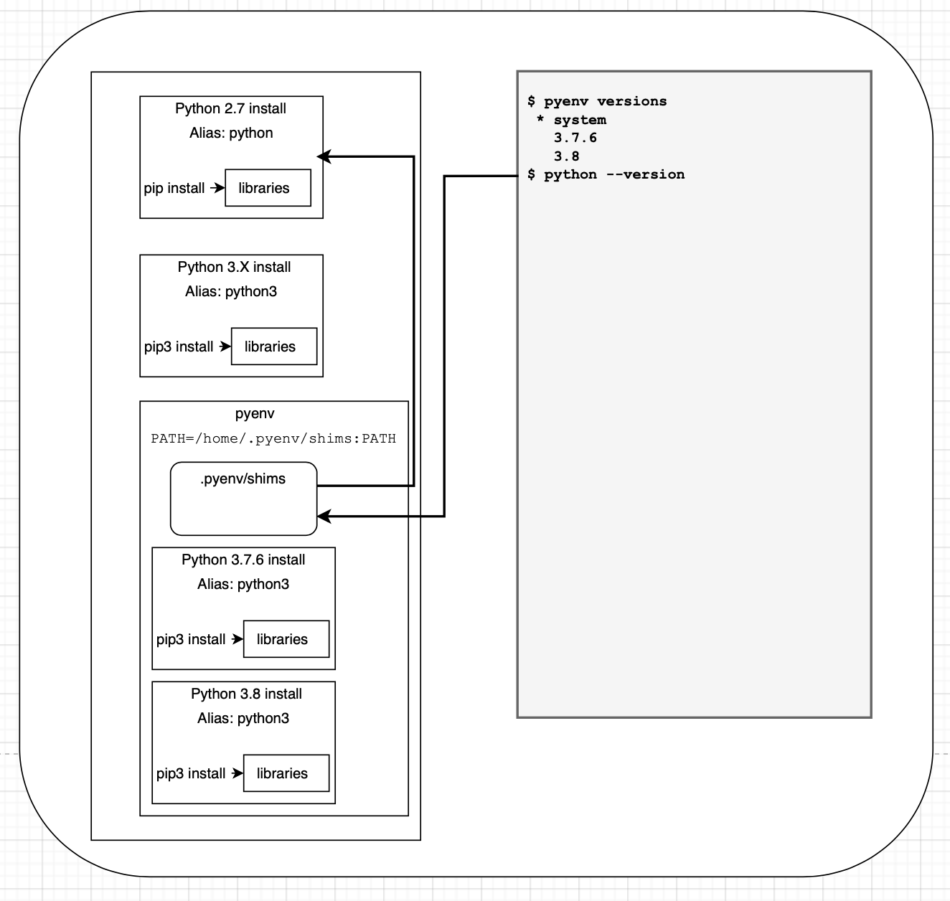
What if I want to use different versions of python on different projects
More and more commonly we will end up working across projects where we need different versions of Python 3 rather than 2 or 3
How can we have two versions of Python 3? How do we make the system decide which version to point at? Aliases was the old method, but this is clunky
Now we have pyenv to handle this for us
Pyenv uses shims to intercept the python command
It adds a shim to your PATH which then calls a shell script to identify which version of Python to use

Slide 6
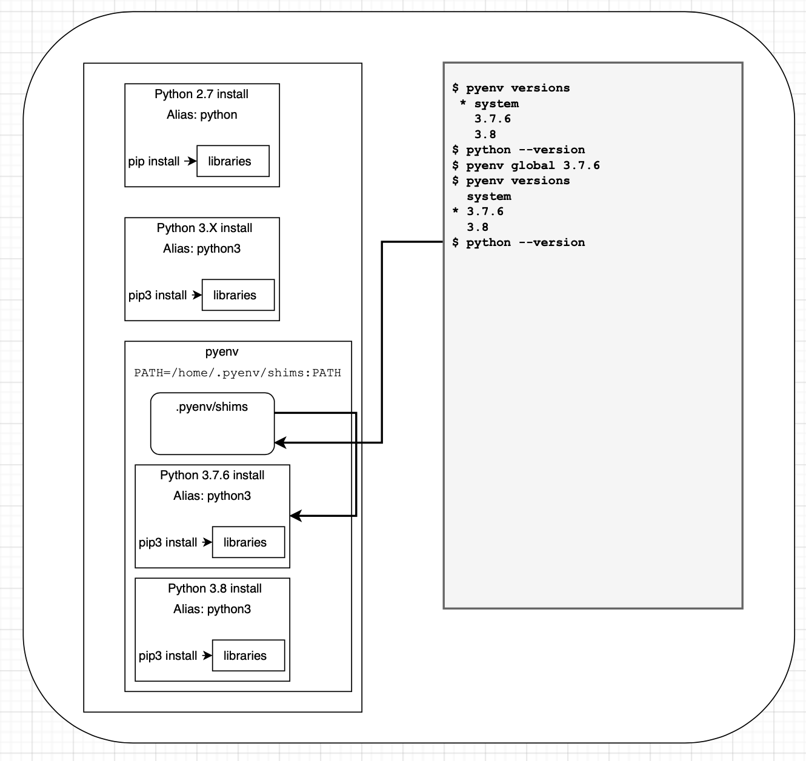
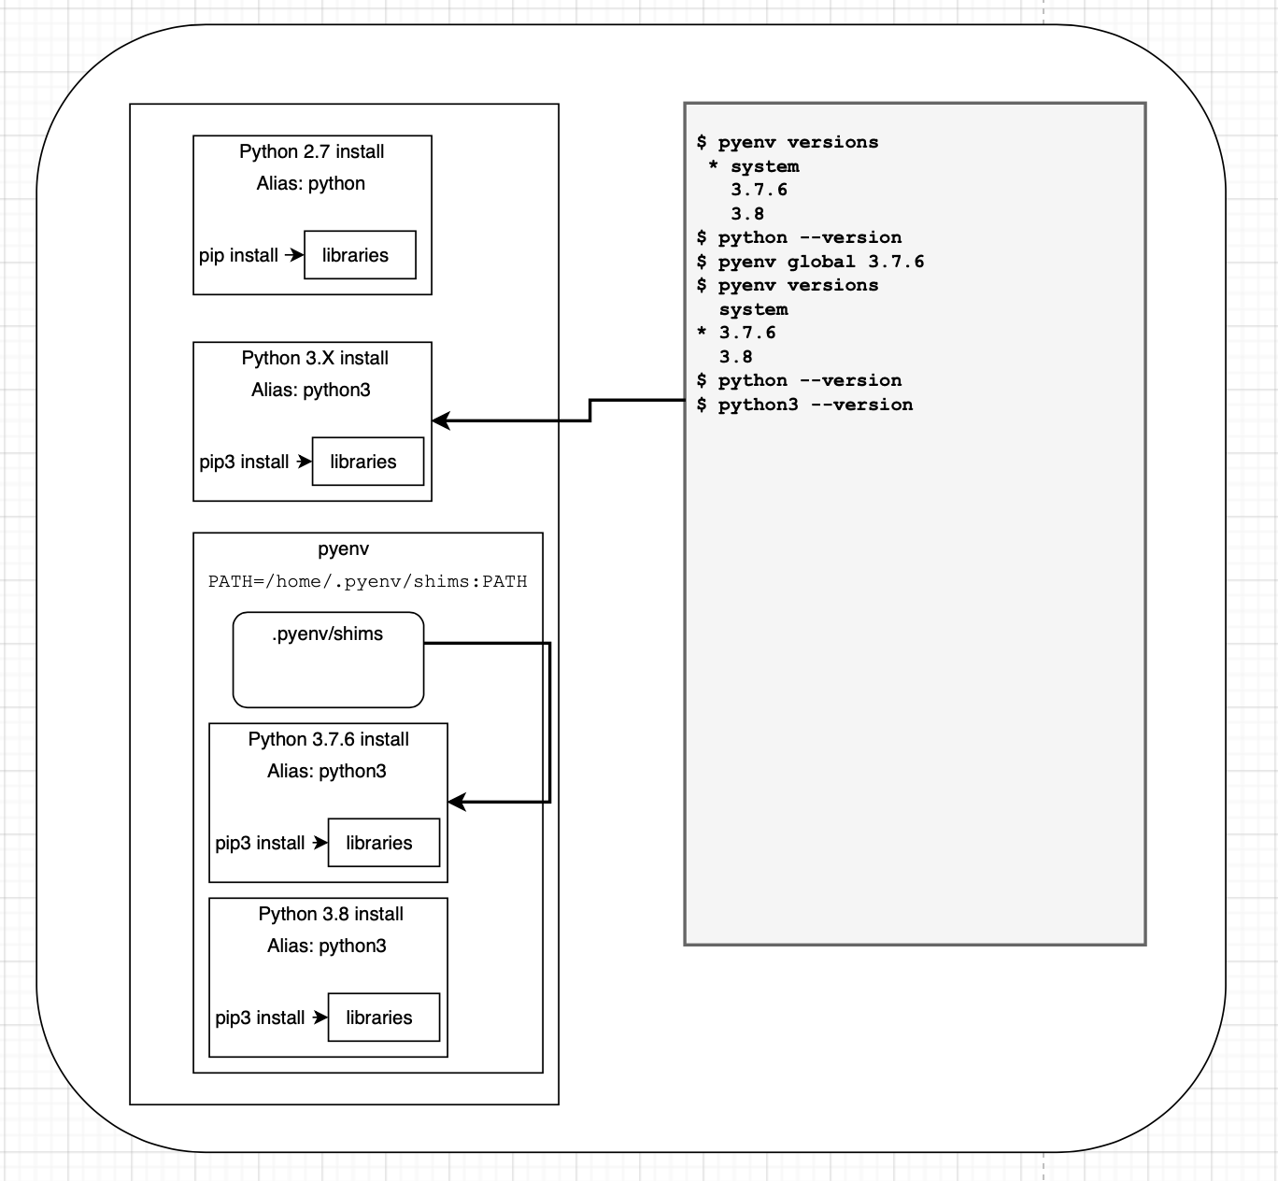
Pyenv shims

Slide 7
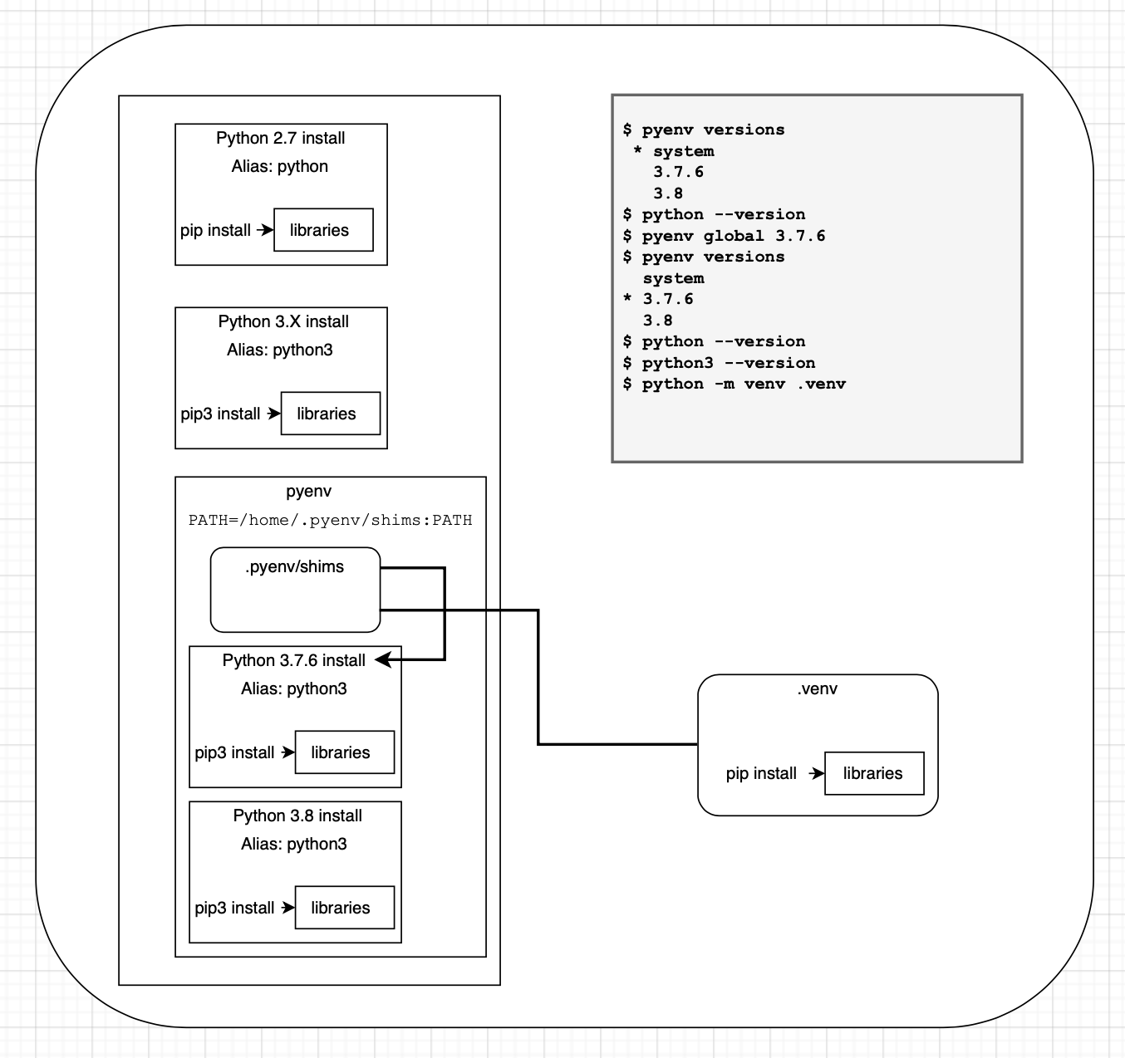
Pyenv with virtual environments
Once pyenv is setup you can create virtual environments as you would normally
Now, the virtual env will just point at the pyenv installation of whichever version is active
Your virtual environment will still be separate from everything else

Slide 8
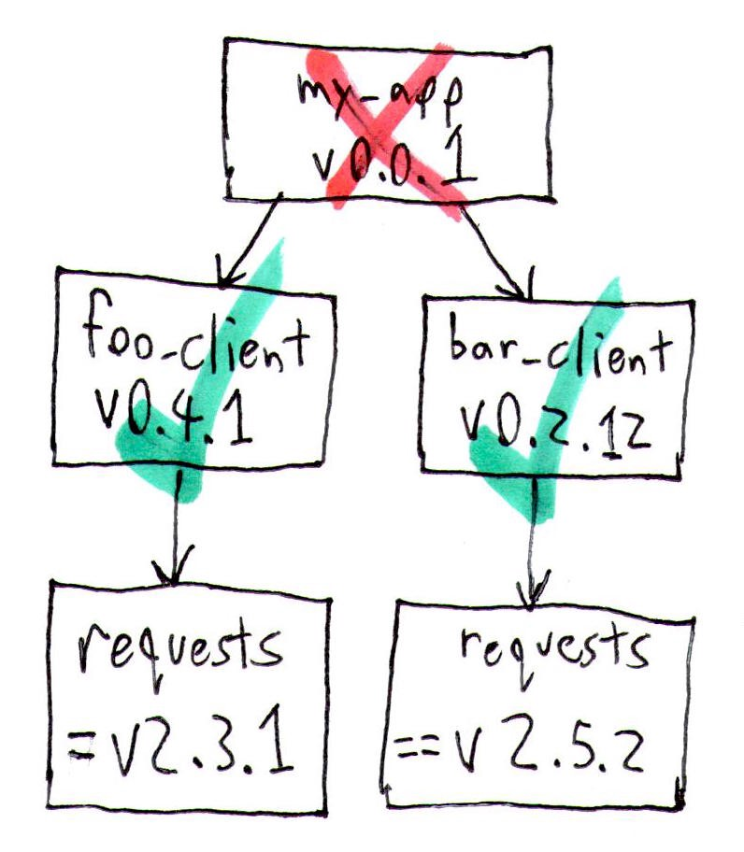
Dependency management
So far, we have concerned ourselves with Python versioning and keeping environments separate, but what about managing dependencies within environments?
A great tool for both dependency management, Python versioning and virtual environments is conda
Unfortunately, their licensing changed, and we can no longer use it for commercial applications without a license
A decent open-source alternative is Poetry, which handles the dependency management, virtual environments and packaging is Poetry
This will make sure that all dependencies are valid
Tools like pip will download and install a package without caring about requirements of other dependencies
Poetry combines a virtual environment tool, dependency manager and packaging tool all in one with only one config

